Slide 1
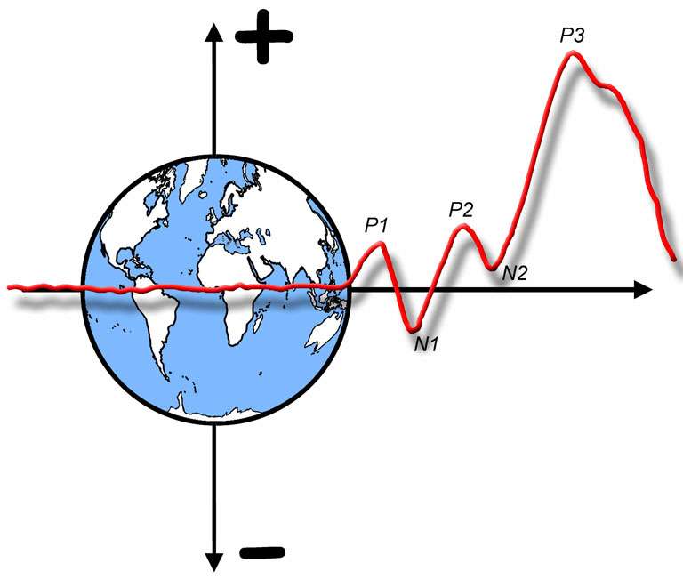

The ERP Boot Camp
Averaging, Overlap, & Convolution

Slide 2
Averaging and S/N Ratio
S/N ratio = (signal size) ÷ (noise size)
2 µV effect, 40 µV EEG noise -> 2:40 = 0.05:1
Acceptable S/N ratio depends on number of subjects
Averaging increases S/N according to sqrt(N)
Doubling N multiplies S/N by a factor of 1.41
Quadrupling N doubles S/N (because sqrt(4) = 2)
If S/N is .05:1 on a single trial, 1024 trials gives us a S/N ratio of 1.6:1
Because sqrt(1024) = 32 and .05 x 32 = 1.6
Ouch!!!
So, how many trials to you actually need?
Two-word answer (begins with “it” and ends with “depends”)
Notes:
© S. J. Luck. All Rights Reserved. May be used for nonprofit educational purposes if this copyright notice is included. Permission must be obtained from the copyright holder(s) for any other use.

Slide 3
# of Trials and Statistical Power
Goal: Determine # of subjects and # of trials needed to achieve a given likelihood of being able to detect a significant difference between conditions/groups
Power depends on:
Size of difference in means between conditions
Variance across subjects (plus within-subject correlation)
Number of subjects
Variance across subjects depends on:
Residual EEG noise that remains after averaging
“True” variance (e.g., some people just have bigger P3s)
Residual EEG noise after averaging depends on:
Amount of noise on single trials (EEG noise + ERP variability)
# of trials averaged together
Notes:
© S. J. Luck. All Rights Reserved. May be used for nonprofit educational purposes if this copyright notice is included. Permission must be obtained from the copyright holder(s) for any other use.

Slide 4
# of Trials and Statistical Power
Put resources into more trials when the single-trial EEG noise is large relative to other sources of variance
Put resources into more subjects when the single-trial EEG noise is small relative to other sources of variance
Notes:
© S. J. Luck. All Rights Reserved. May be used for nonprofit educational purposes if this copyright notice is included. Permission must be obtained from the copyright holder(s) for any other use.

Slide 5
# of Trials and Statistical Power
For my lab’s basic science research, we usually run 10-20 subjects with the following number of trials:
P1: 300-400 trials/condition
N2pc: 150-200 trials/condition
P3/N400: 30-50 trials/condition
We try to double this for studies of schizophrenia
Notes:
© S. J. Luck. All Rights Reserved. May be used for nonprofit educational purposes if this copyright notice is included. Permission must be obtained from the copyright holder(s) for any other use.

Slide 6
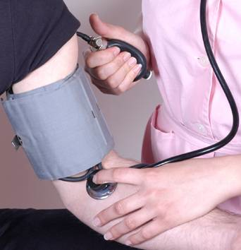
Individual Trials
Averaged Data
Look at prestimulus baseline to see noise level
Notes:
Figure 4.1 from Luck, S. J., An Introduction to the Event-Related Potential Technique. Cambridge, MA: MIT Press. © MIT Press. This material may be used for nonprofit research and education purposes only, and it may not be reprinted or distributed in any form including print and electronic forms.
Other content: © S. J. Luck. All Rights Reserved. May be used for nonprofit educational purposes if this copyright notice is included. Permission must be obtained from the copyright holder(s) for any other use.

Slide 7
Individual Differences
Illusion
Notes:
Adapted from figure 1.3 from Luck, S. J., An Introduction to the Event-Related Potential Technique. Cambridge, MA: MIT Press. © MIT Press. This material may be used for nonprofit research and education purposes only, and it may not be reprinted or distributed in any form including print and electronic forms.
Other content: © S. J. Luck. All Rights Reserved. May be used for nonprofit educational purposes if this copyright notice is included. Permission must be obtained from the copyright holder(s) for any other use.

Slide 8
Individual Differences
Good reproducibility across sessions (assuming adequate # of trials)
Notes:
Adapted from figure 1.3 from Luck, S. J., An Introduction to the Event-Related Potential Technique. Cambridge, MA: MIT Press. © MIT Press. This material may be used for nonprofit research and education purposes only, and it may not be reprinted or distributed in any form including print and electronic forms.
Other content: © S. J. Luck. All Rights Reserved. May be used for nonprofit educational purposes if this copyright notice is included. Permission must be obtained from the copyright holder(s) for any other use.

Slide 9
Explaining Individual Differences
How could a component be negative for one subject?
P2
Notes:
Adapted from Kappenman, E. S., & Luck, S. J. (2012). ERP components: The ups and downs of brainwave recordings. In S. J. Luck & E. S. Kappenman (Eds.), Oxford Handbook of ERP Components. New York: Oxford University Press. Copyright 2010 by Emily S. Kappenman; all rights reserved. May be used for nonprofit educational purposes if this copyright notice is included. Permission must be obtained from the copyright holder(s) for any other use.

Slide 10
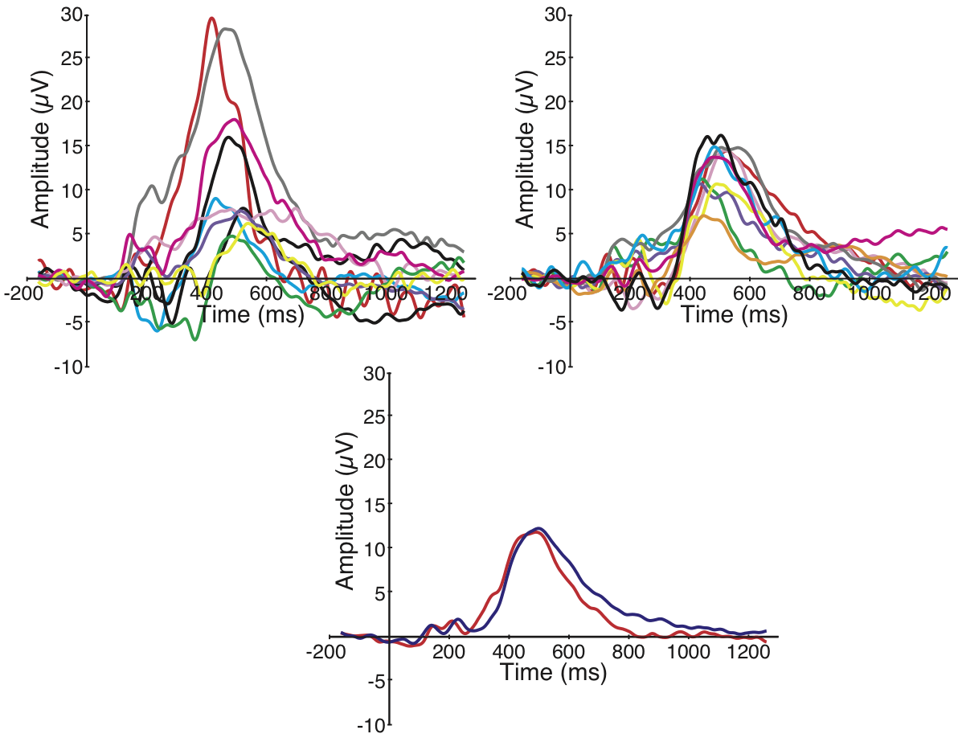
Individual Differences
Grand average of any 10 subjects usually looks much like the grand average of any other 10 subjects
Notes:
Adapted from Kappenman, E. S., & Luck, S. J. (2012). ERP components: The ups and downs of brainwave recordings. In S. J. Luck & E. S. Kappenman (Eds.), Oxford Handbook of ERP Components. New York: Oxford University Press. Copyright 2010 by Emily S. Kappenman; all rights reserved. May be used for nonprofit educational purposes if this copyright notice is included. Permission must be obtained from the copyright holder(s) for any other use.

Slide 11
Key Assumption of Averaging
Assumption: The timing of the ERP signal is the same on each trial
This assumption is often violated, leading to misinterpretations
The stimulus might elicit oscillations that vary in phase or onset time from trial to trial
These will disappear from the average
The timing of a component may vary from trial to trial
This is called “latency jitter”
The average will contain a “smeared out” version of the component with a reduced peak amplitude
The average will be equal to the convolution of the single-trial waveform with the distribution of latencies
Notes:
© S. J. Luck. All Rights Reserved. May be used for nonprofit educational purposes if this copyright notice is included. Permission must be obtained from the copyright holder(s) for any other use.

Slide 12
Latency Jitter
Note: For monophasic waveforms, mean/area amplitude does not change when the degree of latency jitter changes
Notes:
© S. J. Luck. All Rights Reserved. May be used for nonprofit educational purposes if this copyright notice is included. Permission must be obtained from the copyright holder(s) for any other use.

Slide 13
Example of Latency Variability
Luck & Hillyard (1990)
Notes:
© S. J. Luck. All Rights Reserved. May be used for nonprofit educational purposes if this copyright notice is included. Permission must be obtained from the copyright holder(s) for any other use.

Slide 14
Example of Latency Variability
Parallel Search
Serial Search
Luck & Hillyard (1990)
Notes:
© S. J. Luck. All Rights Reserved. May be used for nonprofit educational purposes if this copyright notice is included. Permission must be obtained from the copyright holder(s) for any other use.

Slide 15
Latency Jitter & Convolution
How exactly does the averaged ERP waveform change as a function of latency jitter?
“Convolution” gives us the answer
E = single-trial ERP waveform
L = probability distribution of single-trial ERP latencies
Averaged ERP = E * L
(“*” means “convolution”)
Convolution also explains:
Effects of overlap on averaged ERP waveform
Effects of stimulus timing errors on averaged ERP waveform
How filters work
How time-frequency analysis works
Fortunately, convolution is really simple
Notes:
© S. J. Luck. All Rights Reserved. May be used for nonprofit educational purposes if this copyright notice is included. Permission must be obtained from the copyright holder(s) for any other use.

Slide 16
RT Distributions
Frequency
Distribution
Probability
Distribution
Notes:
© S. J. Luck. All Rights Reserved. May be used for nonprofit educational purposes if this copyright notice is included. Permission must be obtained from the copyright holder(s) for any other use.

Slide 17
RT Distributions
Difference is mainly in the amount of right skew, not a shift of the whole distribution
Notes:
© S. J. Luck. All Rights Reserved. May be used for nonprofit educational purposes if this copyright notice is included. Permission must be obtained from the copyright holder(s) for any other use.

Slide 18
P3 Latency Distribution
If P3 is time-locked to the response, then P3 probability distribution = RT probability distribution
17% of P3s at 350 ms
25% of P3s at 400 ms
Probability of P3 Peak Latency
7% of P3s at 300 ms
Time
Notes:
© S. J. Luck. All Rights Reserved. May be used for nonprofit educational purposes if this copyright notice is included. Permission must be obtained from the copyright holder(s) for any other use.

Slide 19
Averaging & Convolution
Hypothetical Single-Trial P3 Waveforms
P3 when RT = 400 ms
P3 when RT = 500 ms
ERP Amplitude
(Assumes P3 peaks at RT)
Time
Notes:
© S. J. Luck. All Rights Reserved. May be used for nonprofit educational purposes if this copyright notice is included. Permission must be obtained from the copyright holder(s) for any other use.

Slide 20
Averaging & Convolution
Average(A, B, C, D) = (A+B+C+D)÷4
Sum of 17 P3s at 350 ms
Sum of 25 P3s at 400 ms
Sum of 7 P3s at 300 ms
Notes:
© S. J. Luck. All Rights Reserved. May be used for nonprofit educational purposes if this copyright notice is included. Permission must be obtained from the copyright holder(s) for any other use.

Slide 21
Averaging & Convolution
Average(A, B, C, D) = (A+B+C+D)÷4
Sum of Sums
Average =
Sum of Sums ÷ N
Notes:
© S. J. Luck. All Rights Reserved. May be used for nonprofit educational purposes if this copyright notice is included. Permission must be obtained from the copyright holder(s) for any other use.

Slide 22
Averaging & Convolution
Average(A, B, C, D) = .25A + .25B + .25C + .25D
.17 x P3
at 350 ms
.25 x P3
at 400 ms
Average =
Sum of Scaled and Shifted Single-Trial P3 Waveforms
.7 x P3
at 300 ms
Notes:
© S. J. Luck. All Rights Reserved. May be used for nonprofit educational purposes if this copyright notice is included. Permission must be obtained from the copyright holder(s) for any other use.

Slide 23
Averaging & Convolution
Average(A, B, C, D) = .25A + .25B + .25C + .25D
We are replacing each point in the latency distribution (function A) with a scaled and shifted P3 waveform (function B)
This is called convolving function A and function B
(“A * B”)
This is mathematically equivalent to filtering the single-trial waveforms
Notes:
© S. J. Luck. All Rights Reserved. May be used for nonprofit educational purposes if this copyright notice is included. Permission must be obtained from the copyright holder(s) for any other use.

Slide 24
The Overlap Problem
Notes:
Fig 4.5 of Luck, Steven J. (2005). An introduction to the Event-Related Potential Technique. Cambridge, MA: MIT Press.© MIT Press. This material may be used for nonprofit research and education purposes only, and it may not be reprinted or distributed in any form including print and electronic forms.

Slide 25
Notes:
Adapted from Figure 11.5 from Luck, S.J. (2014). An Introduction to the Event-Related Potential Technique, Second Edition. Cambridge, MA: MIT Press. © MIT Press.
This material may be used for nonprofit research and education purposes only, and it may not be reprinted or distributed in any form including print and electronic forms.

Slide 26
Convolution & Filtering
Frequency response function of low-pass filter
Notes:
Fig 4.5 of Luck, Steven J. (2005). An introduction to the Event-Related Potential Technique. Cambridge, MA: MIT Press.© MIT Press. This material may be used for nonprofit research and education purposes only, and it may not be reprinted or distributed in any form including print and electronic forms.

Slide 27
Notes:
Adapted from Figure 11.6 in Luck, S.J. (2014). An Introduction to the Event-Related Potential Technique, Second Edition. Cambridge, MA: MIT Press. © MIT Press.
This material may be used for nonprofit research and education purposes only, and it may not be reprinted or distributed in any form including print and electronic forms.

Slide 28
Convolution & Filtering
Notes:
Adapted from Figure 11.7 from Luck, S.J. (2014). An Introduction to the Event-Related Potential Technique, Second Edition. Cambridge, MA: MIT Press. © MIT Press.
This material may be used for nonprofit research and education purposes only, and it may not be reprinted or distributed in any form including print and electronic forms.

Slide 29
Convolution & Filtering
Notes:
Adapted from Figure 11.7 from Luck, S.J. (2014). An Introduction to the Event-Related Potential Technique, Second Edition. Cambridge, MA: MIT Press. © MIT Press.
This material may be used for nonprofit research and education purposes only, and it may not be reprinted or distributed in any form including print and electronic forms.

Slide 30
When Overlap is Not a Problem
Overlap is not usually a problem when it is equivalent across conditions
Exception: Scalp Distribution
Kutas & Hillyard (1980)
Notes:
Figure 1 from Kutas, M., & Hillyard, S. A. (1980). Reading senseless sentences: Brain potentials reflect semantic incongruity. Science, 207, 203-205. Reproduced with permission of AMERICAN ASSOCIATION FOR THE ADVANCEMENT OF SCIENCE.

Slide 31
Overlap Distorts Scalp Distribution
Notes:
Adapted from Figure 11.4 in Luck, S.J. (2014). An Introduction to the Event-Related Potential Technique, Second Edition. Cambridge, MA: MIT Press. © MIT Press.
This material may be used for nonprofit research and education purposes only, and it may not be reprinted or distributed in any form including print and electronic forms.

Slide 32
Steady-State ERPs
Stimuli (clicks)
EEG
SOA is constant, so the overlap is not temporally smeared
Notes:
© S. J. Luck. All Rights Reserved. May be used for nonprofit educational purposes if this copyright notice is included. Permission must be obtained from the copyright holder(s) for any other use.

Slide 33
Steady-State ERPs
Advantage of Steady-State:
You can quantify the amplitude of the signal by doing a Fourier transform and looking at the amplitude (or power) at the stimulation frequency
Noise at other frequencies does not impact your amplitude/power measure, so the measure is extremely reliable with a relatively small amount of recording time
Notes:
© S. J. Luck. All Rights Reserved. May be used for nonprofit educational purposes if this copyright notice is included. Permission must be obtained from the copyright holder(s) for any other use.

Slide 34
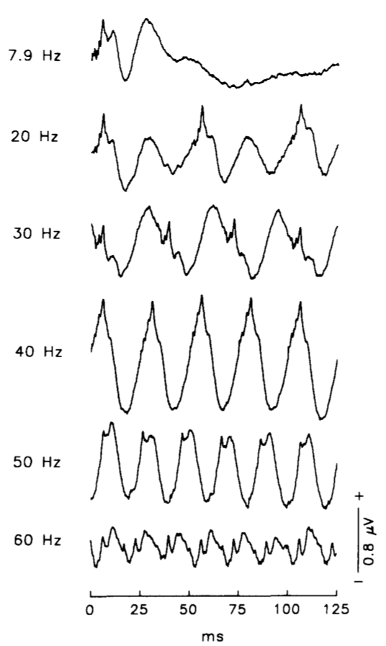
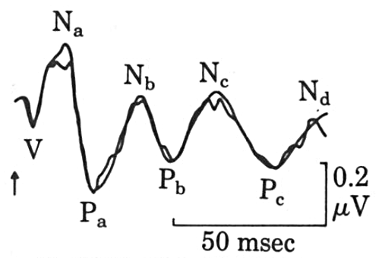
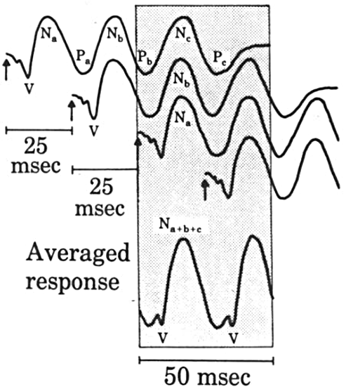
Battista Azzena et al. (1995)
Galambos et al. (1981)
Transient ERP
Notes:
Left portion reprinted from Battista Azzena, G., Conti, G., Santarelli, R., Ottaviani, F., Paludetti, G., & Maurizi, M. (1995). Generation of human auditory steady-state responses (SSRs). I: Stimulus rate effects. Hearing Research, 83, 1-8, copyright 1995, with permission from Elsevier
Right portion reprinted from Galambos, R., Makeig, S., & Talmachoff, P. J. (1981). A 40-Hz auditory potential recorded from the human scalp. Proceedings of the National Academy of Sciences, 78, 2643-2647, with permission of S. Makeig.
Other content: © S. J. Luck. All Rights Reserved. May be used for nonprofit educational purposes if this copyright notice is included. Permission must be obtained from the copyright holder(s) for any other use.

Slide 35
Woody Filtering
Notes:
© S. J. Luck. All Rights Reserved. May be used for nonprofit educational purposes if this copyright notice is included. Permission must be obtained from the copyright holder(s) for any other use.

Slide 36
Woody Filtering
Johnson, Pfefferbaum, & Kopell (1985)
Notes:
Figure 7 reprinted from Johnson, Pfefferbaum, & Kopell (1985) P300 and Long-Term Memory: Latency Predicts Recognition Performance. Psychophysiology 22,5 497-507, with permission from Blackwell Publishing. © Blackwell Publishing. This material may be used for nonprofit research and education purposes only, and it may not be reprinted or distributed in any form including print and electronic forms.

